Slide 1
Azure User Group Bulgaria
Facebook https://www.facebook.com/groups/azureugbg/
Meetup https://www.meetup.com/Azure-User-Group-Bulgaria/
Github https://github.com/AzureUserGroupBulgaria
Slack https://azureugbg.slack.com/
#AzureUGBG

Slide 2

Peer to peer lending in Microsoft Azure
Nikolay Stanev
Software advisor @ Klearlending

Slide 3

AGENDA
What is P2P lending
Platform components
Logical view of the platform
Design concepts
Physical (almost) view
Aspects

Slide 4
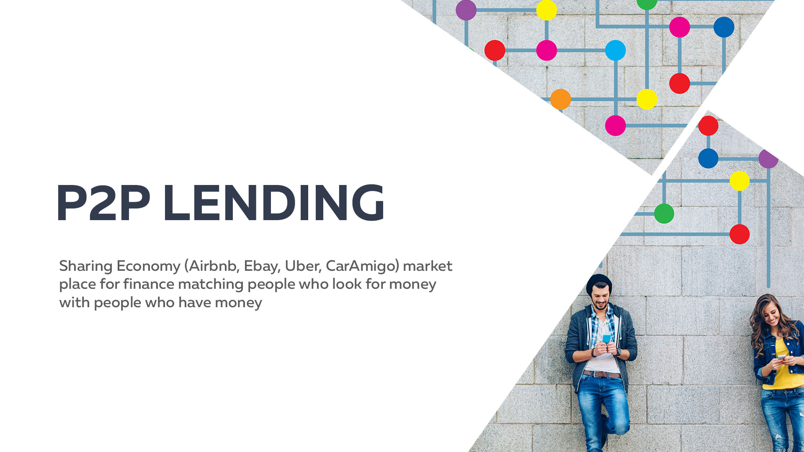


Slide 5
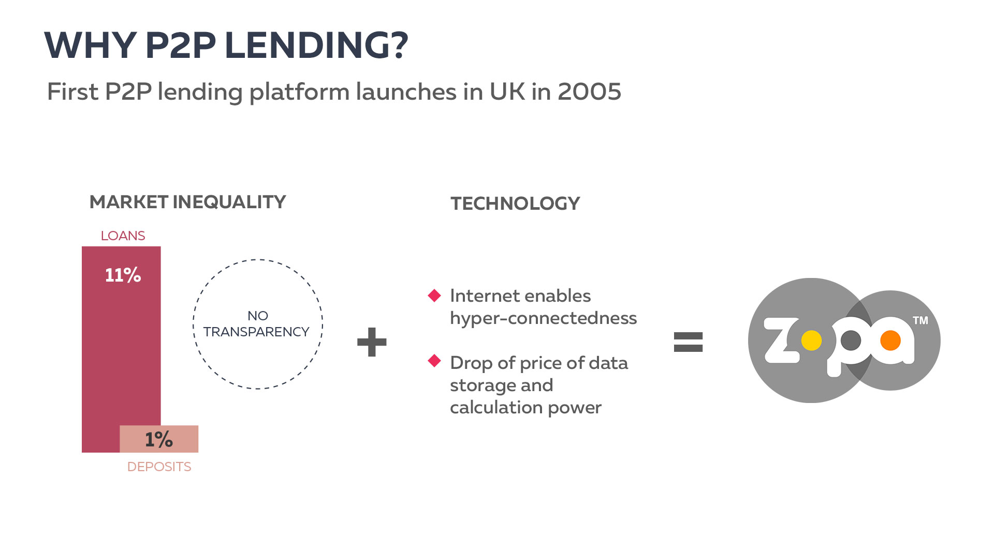

Slide 6
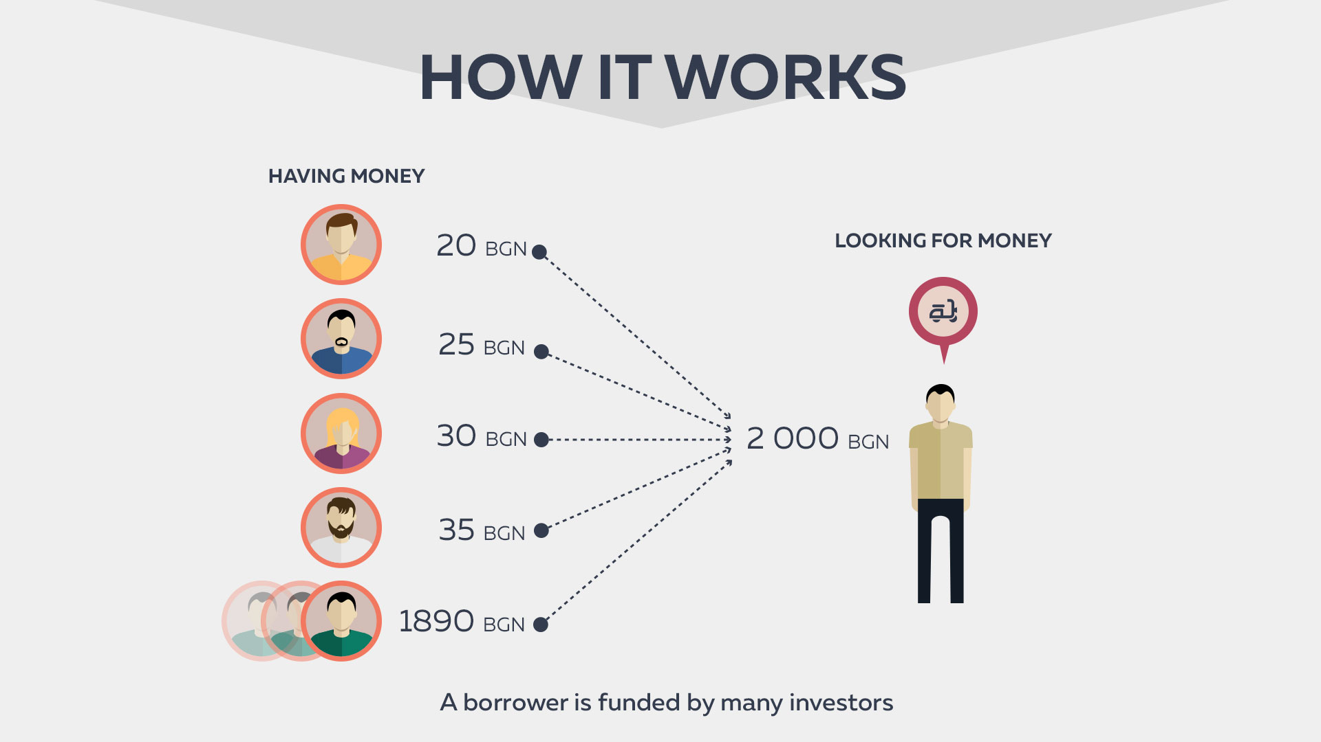

Slide 7
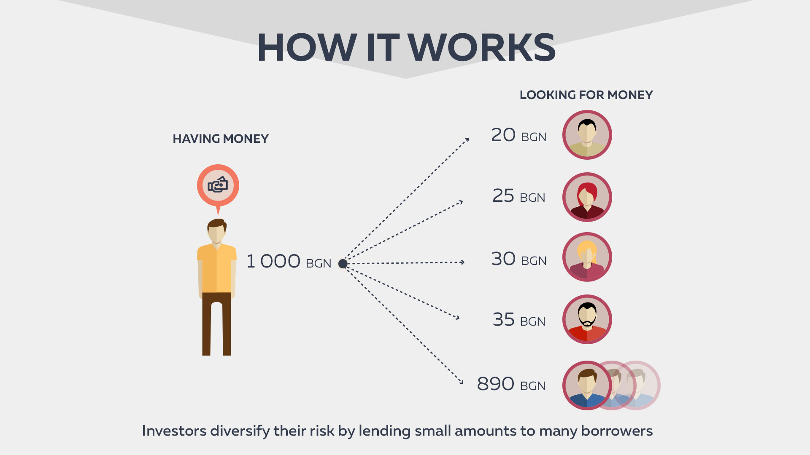

Slide 8


Slide 9
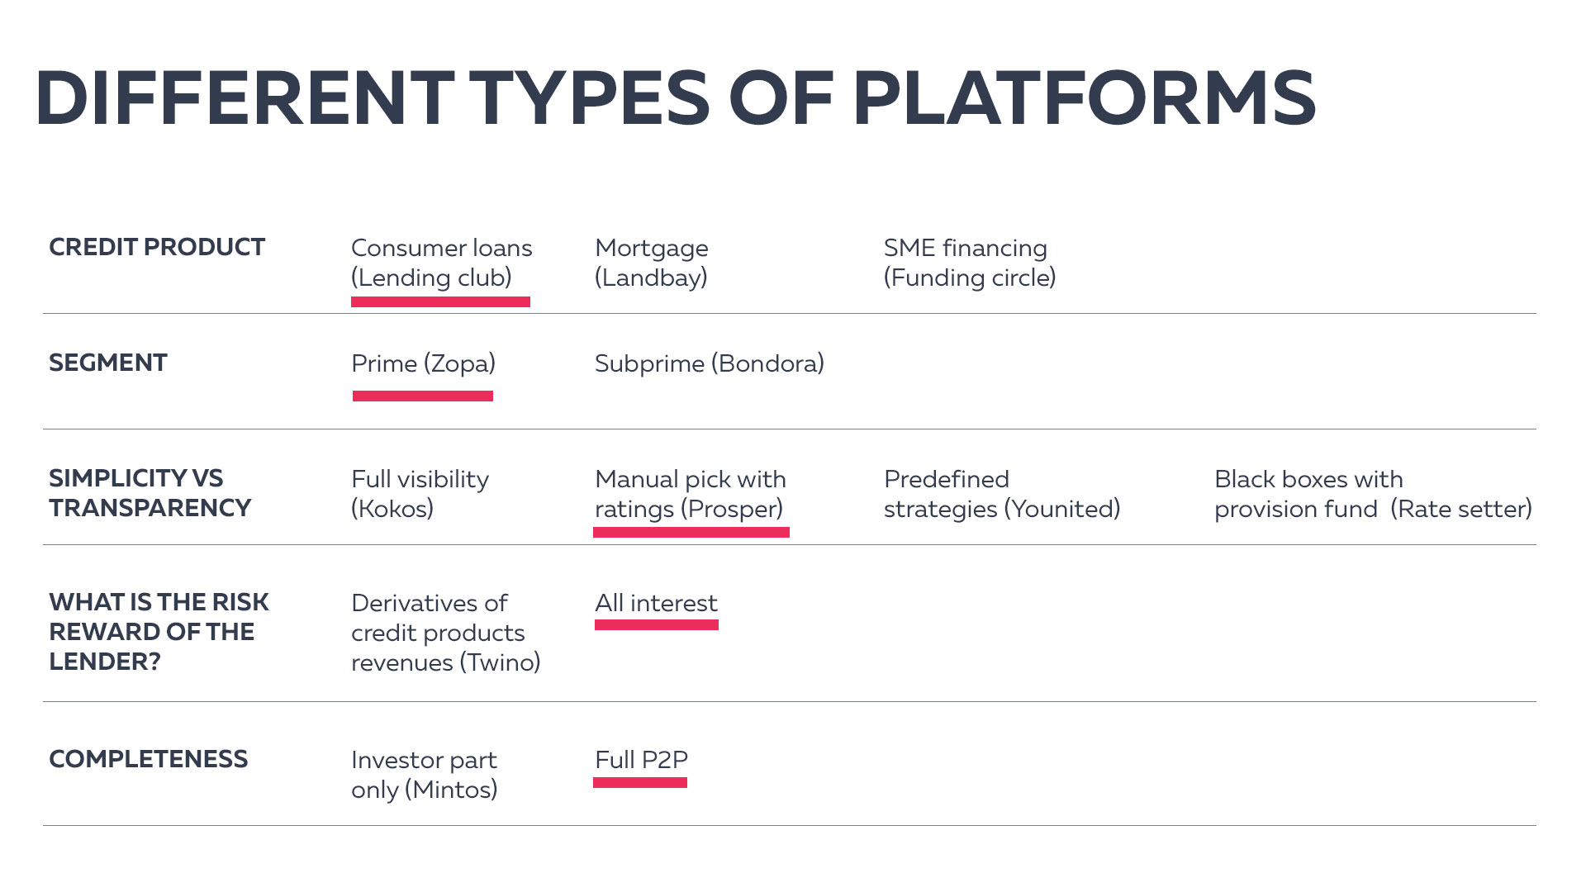

Slide 10
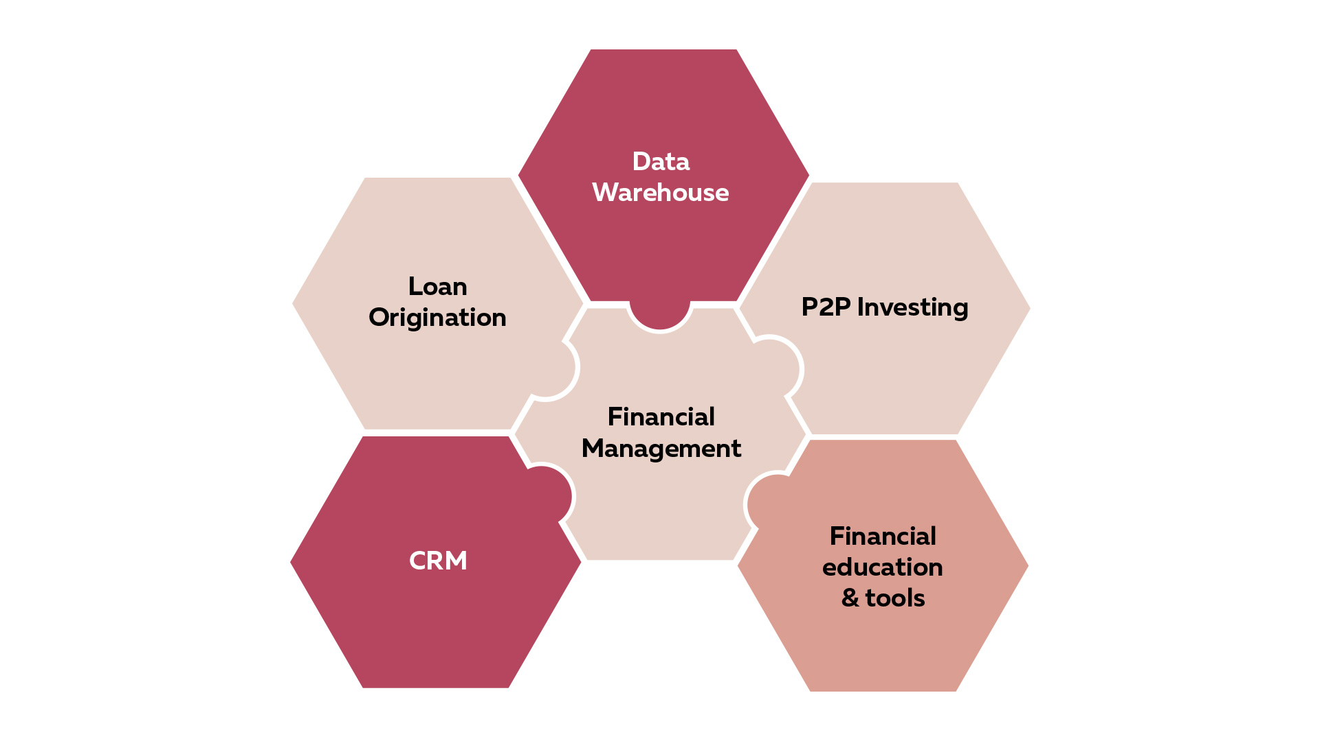
Components

Slide 11
LOAN ORIGINATION
Credit application
Customer assessment
Based on
Application data
External checks
Automatic
Expert system
Machine learning – in progress
Manual
Price segmentation
Verification

Slide 12

PEER-TO-PEER INVESTING
Investor registration and verification
Market management
Portfolio management
Repayment management
Statistics

Slide 13

LOAN MANAGEMENT
Financing
Due dates
Repayment
Early repayments
Due date changes
Postponements
Accounting
BNB reporting

Slide 14
CRM
Track of customer interaction
Financial activities
Marketing segmentation

Slide 15
FINANCIAL EDUCATION
Blog
Budget tool
Get best loan condition
Debt advice(in progress)

Slide 16
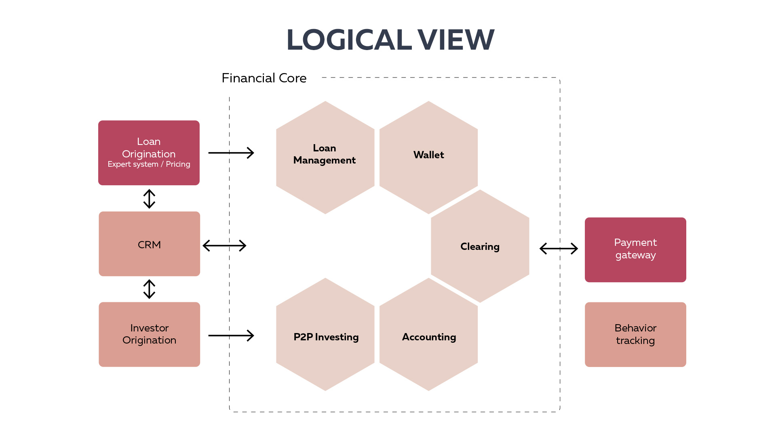

Slide 17

STACK
.Net Framework 4.6.1
ASP.NET MVC
Angular.js
SQL Server
RavenDB

Slide 18
DESIGN CONCEPTS
CQRS
Event sourcing
Service Bus

Slide 19
CQRS
Command Query Responsibility Segregation
Pattern that segregates the operations that read data (queries) from the operations that update data (commands) by using separate interfaces
https://martinfowler.com/bliki/CQRS.html
http://udidahan.com/2009/12/09/clarified-cqrs/

Slide 20
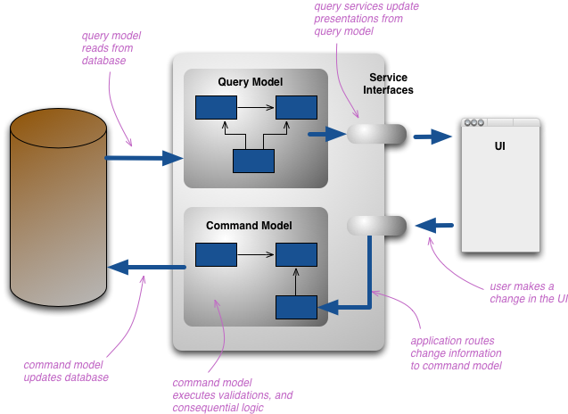
CQRS

Slide 21
EVENT SOURCING
Event Sourcing ensures that all changes to application state are stored as a sequence of events.
Event log can be used to reconstruct past states
Data could be projected in different shapes after the event is stored

Slide 22
SERVICE BUS
Publish subscribe mechanism
Different transports
Memory
DB
Queue
Azure Service Bus
Handles business events
Handles Event Sourcing and data projection
Poison message handling
Synchronizes read models
Aspects for event handlers

Slide 23
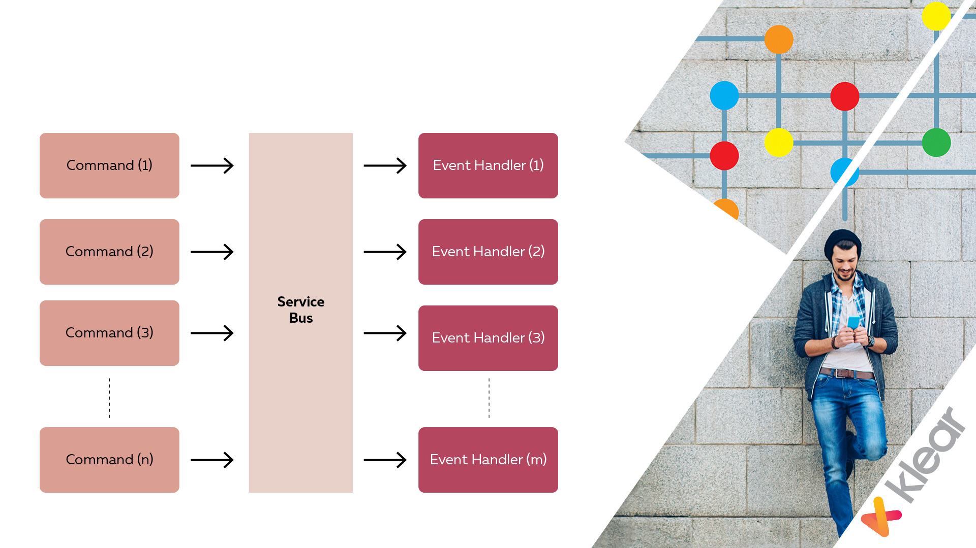
SERVICE BUS

Slide 24
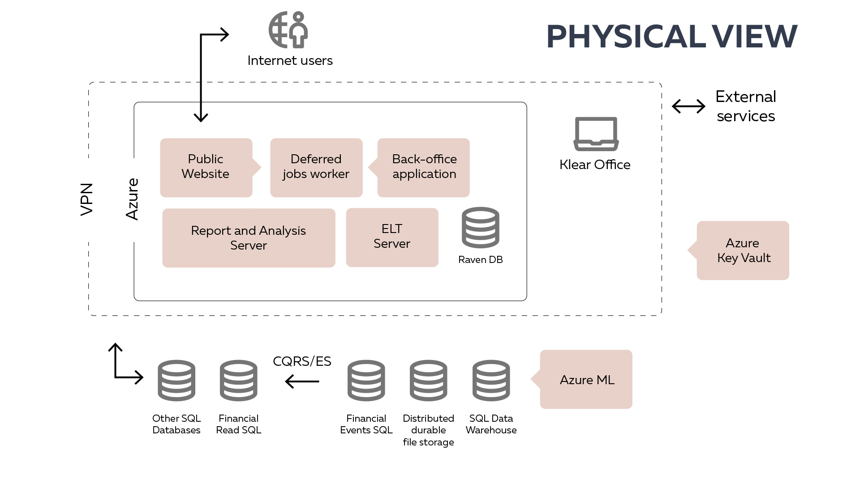

Slide 25
AZURE SERVICES
App Service Environment
App Service
SQL Database
VNET
VNET Gateway
Virtual Machine
Storage
Key Vault
Data Warehouse
Azure ML

Slide 26
APP SERVICE ENVIRONMENT
Fully isolated and dedicated environment for securely running Azure App Service apps
Always part of a virtual network
Fixed IP
Up to 3 working pools for different purposes
Could be put behind internal or external load balancer
https://docs.microsoft.com/en-us/azure/app-service-web/app-service-app-service-environment-intro

Slide 27
APP SERVICE
Multiple languages and frameworks
DevOps optimization
Global scale with high availability
Connections to SaaS platforms and on-premises data
Application templates
Visual Studio integration

Slide 28
APP SERVICE
Hosts public web site
Hosts back-office web site
Runs jobs
Publishes event to Service Bus
Subscribes to and processes events from Service Bus

Slide 29
SQL DATABASE
Scalable
Secure
High availability
Build-in Upgrade
Disaster recovery
Elastic pools
Point in time restore (even on deleted databases)
Geo-replication
Transparent data encryption

Slide 30
VNET
Logical isolation of the Azure cloud dedicated to your subscription

Slide 31
VIRTUAL MACHINE
Scalable
Availability sets
Multiple platforms
Disks can be encrypted

Slide 32
VIRTUAL MACHINE
Raven DBs
ELT server
Report and analysis server

Slide 33
STORAGE
BLOB
Queue
Table

Slide 34
STORAGE
Business Documents
Application Logs
SQL Audit logs
Autogenerated Reports
Virtual machine disks

Slide 35
KEY VAULT
Safeguard and control certificates, cryptographic keys and other secrets - users, passwords..

Slide 36
SQL DATAWAREHOUSE
Massively parallel processing architecture
Separated compute and storage components
Scalable
Performance on demand
Flexible load process
https://docs.microsoft.com/en-us/azure/sql-data-warehouse/sql-data-warehouse-overview-what-is

Slide 37
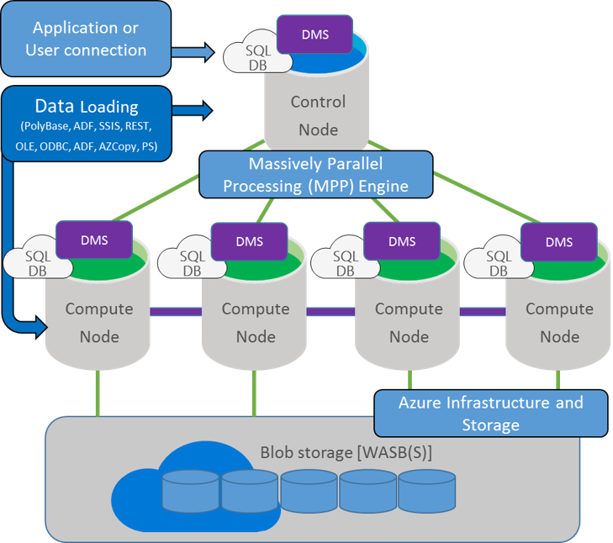
SQL DATAWAREHOUSE

Slide 38
SQL DATAWAREHOUSE
ELT instead of ETL
Anonymized data
Scale Up during the load and transformation and Scale Down after

Slide 39
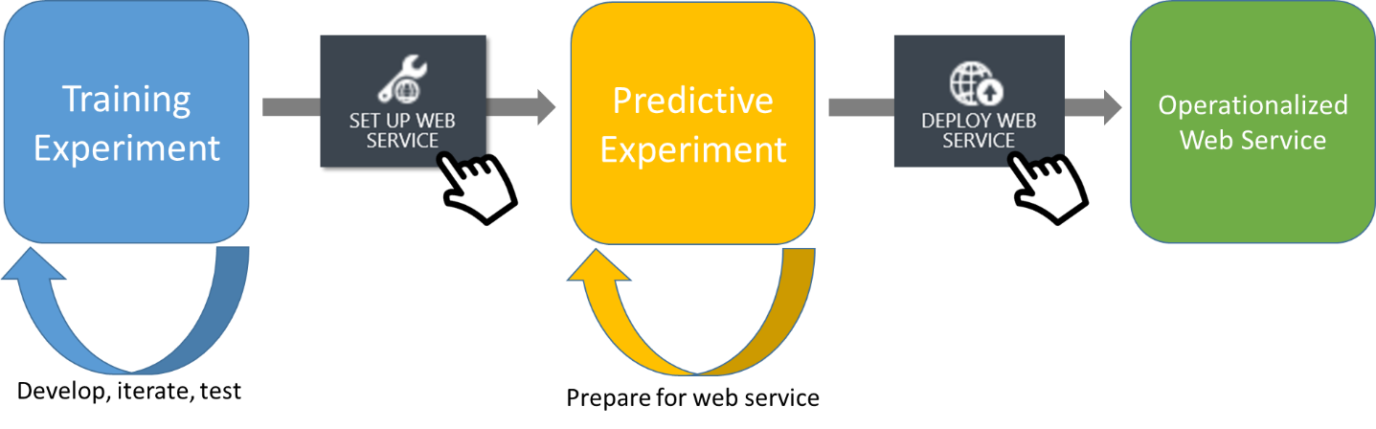
AZURE MACHINE LEARNING
A fully managed cloud service that enables you to easily build, deploy, and share predictive analytics solutions.
Result is exposed as Web Service
R
Python

Slide 40
AZURE MACHINE LEARNING
Credit approval / rejection
Credit score
Content suggestions
Marketing segmentation
https://docs.microsoft.com/en-us/azure/machine-learning/machine-learning-what-is-machine-learning

Slide 41
ASPECTS
Continuous integration
Security and compliance
Performance and scalability
Availability

Slide 42
CONTINUOUS INTEGRATION
Bitbucket as source repository
DEV, UAT, PRE and PROD environments
Deployment slots for Production
??Continuous Delivery in Visual Studio Team Services

Slide 43
SECURITY AND COMPLIANCE
HTTPS Only
Multi-Factor Authentication
Data encrypted at rest
Azure SQL Database firewall
Always encrypted for sensitive data
Azure Key Vault for sensitive information
Data auditing and threat detection

Slide 44
Security is all about risk mitigation -you never actually become “secure”, you merely decrease your risk.
https://azure.microsoft.com/en-us/support/trust-center/
https://docs.microsoft.com/en-us/azure/sql-database/sql-database-security-overview

Slide 45
PERFORMANCE AND SCALABILITY
Horizontal and vertical scale
Application Insights for telemetry
Internal logic for watching the performance degradation

Slide 46
AVAILABILITY
Data and storage geo redundancy
Availability sets for Virtual machines
SLA App Service 99.95%
SLA SQL Database 99.99%
SLA Storage 99.99%
SLA Virtual Machine 99.95%
https://azure.microsoft.com/en-us/support/legal/sla/summary/

Slide 47
SUMMARY
What is P2P lending
Platform components
Logical view of the platform
Design concepts
Physical (almost) view
Aspects

Slide 48
QUESTIONS??

Slide 49
THANK YOU

Slide 50
Nikolay Stanev Software advisor @ klearlending.com
nsstanev@gmail.com
nikolay@klearlending.com
https://twitter.com/nsstanev
https://www.linkedin.com/in/nikolaystanev/
https://www.klearlending.com/
0888 418 745

